Slide 6

How to Exceed
Customer & Employee
Expectations
in a Post-Covid World
Ted Janusz

Slide 7
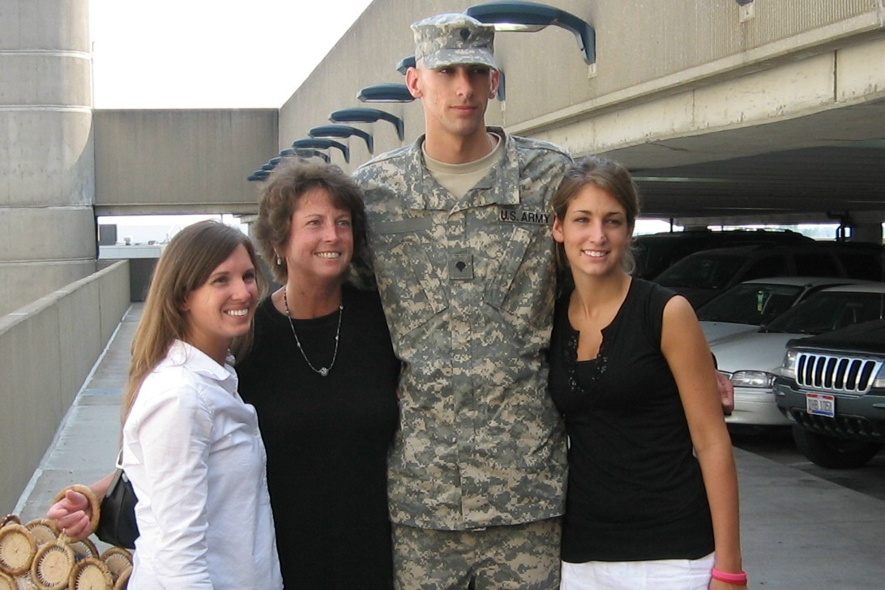

Slide 8
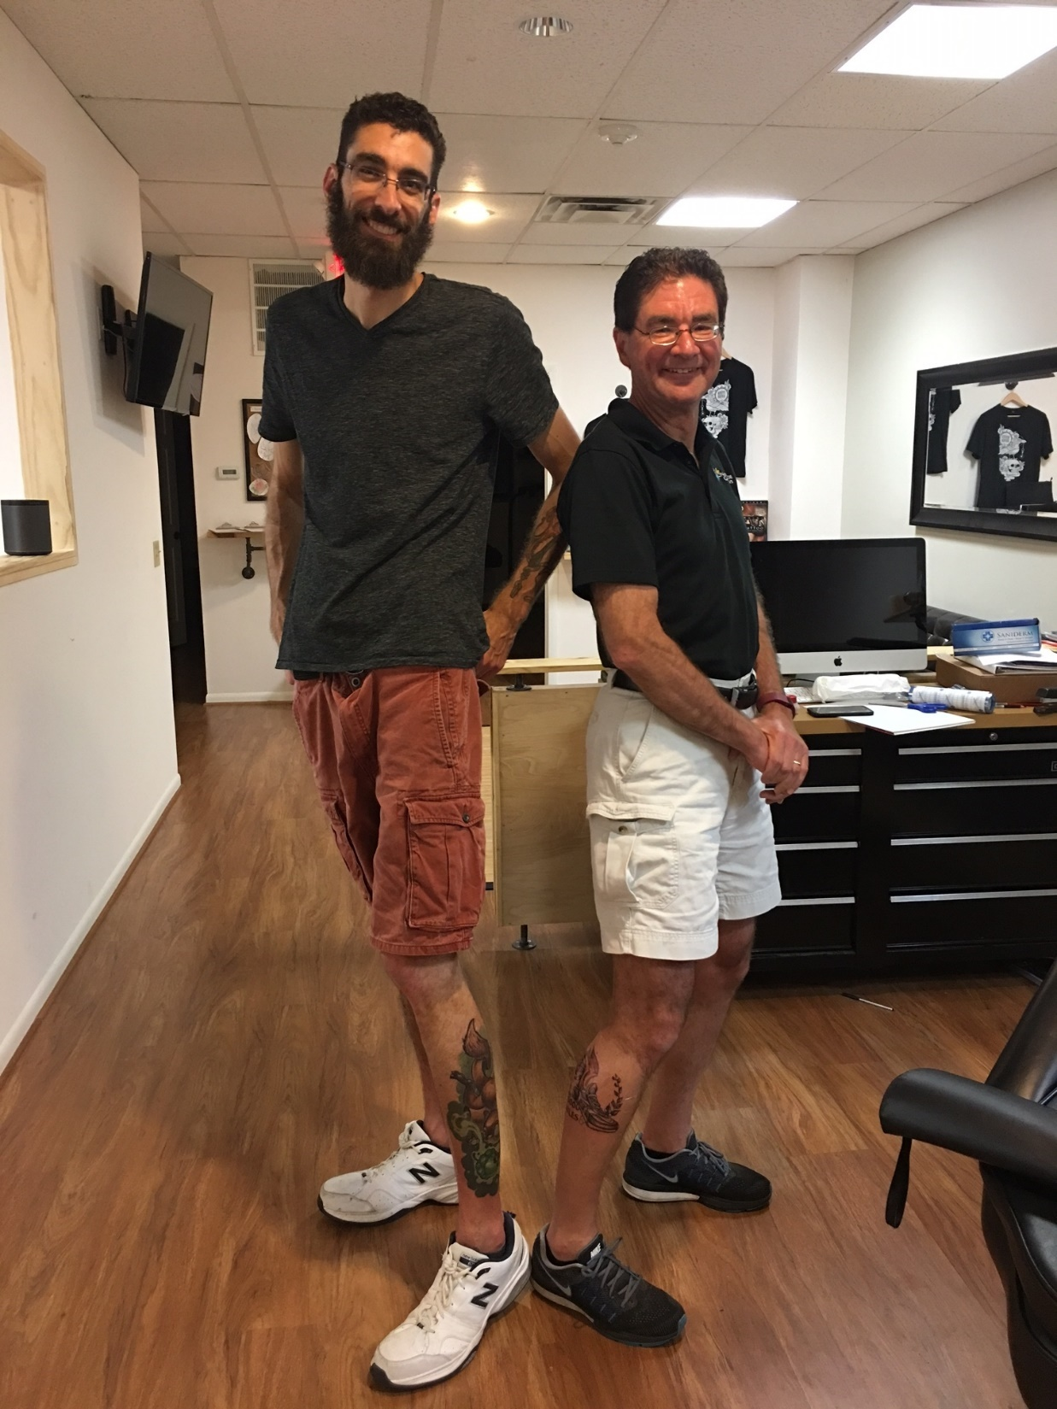

Slide 9

15%
85%

Slide 10
EMPLOYEE BEHAVIORAL STYLES
ANALYTICAL

Slide 11

ANALYTICAL
Perfectionist, primarily likes detail and working with processes or technology, rather than people
“I think …”

Slide 12
EMPLOYEE BEHAVIORAL STYLES
ANALYTICAL
AMIABLE

Slide 13

AMIABLE
Friendly, calm, loyal, likes to get along with people, hates conflict, gets attached to people and things, doesn’t “rock the boat”
“I feel …”

Slide 14
EMPLOYEE BEHAVIORAL STYLES
ANALYTICAL
ADMINISTRATOR
AMIABLE

Slide 15

ADMINISTRATOR
Impatient, bottom-line oriented, “type A personality,” blunt, desires results, lets nothing stand in his/her way!
“I know …”

Slide 16
EMPLOYEE BEHAVIORAL STYLES
ANALYTICAL
ADMINISTRATOR
AMIABLE
ASSOCIATOR

Slide 17
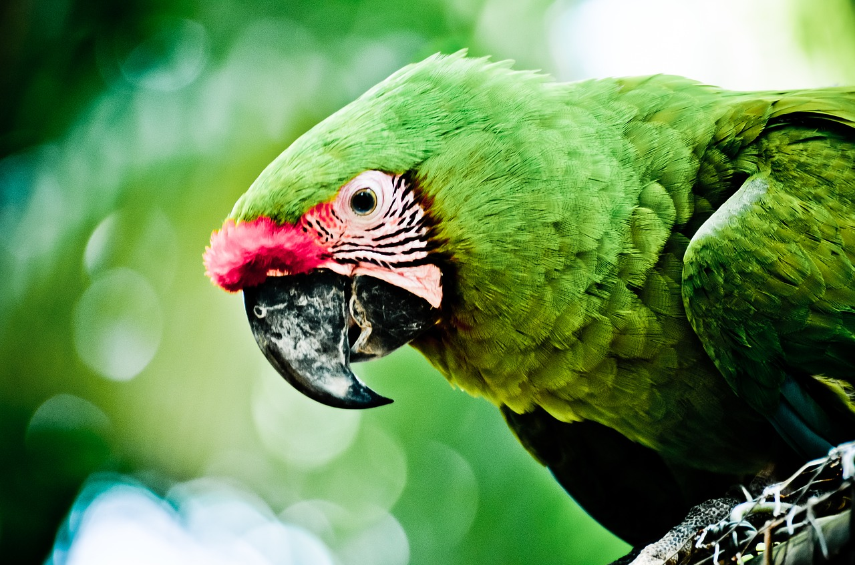

ASSOCIATOR
Dramatic, a “talker,” likes to talk about favorite subject - self, visionary, big-picture oriented, not organized, not into details
“I believe …”

Slide 18
EMPLOYEE BEHAVIORAL STYLES
ANALYTICAL
ADMINISTRATOR
AMIABLE
ASSOCIATOR

Slide 19
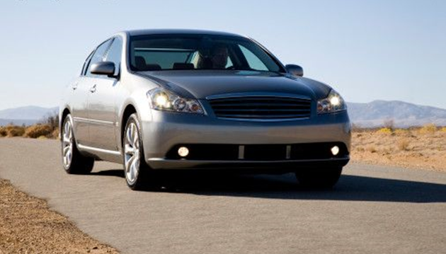
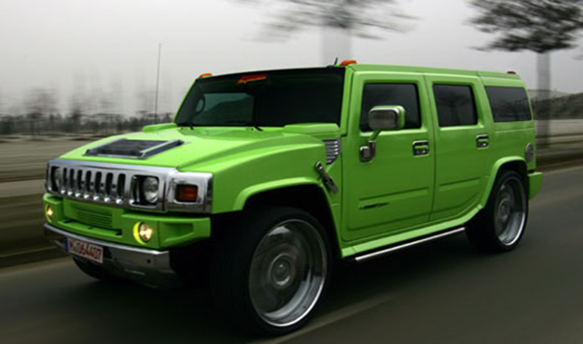
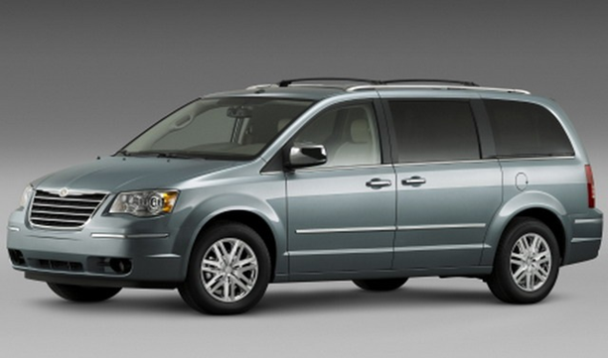

EMPLOYEE BEHAVIORAL STYLES

Slide 20
EMPLOYEE BEHAVIORAL STYLES
ANALYTICAL
ADMINISTRATOR
AMIABLE
ASSOCIATOR

Slide 21
EMPLOYEE BEHAVIORAL STYLES
What is your predominant behavioral style(s)?
What might somebody complain about the behavior(s) of that style(s)?
What could you do or have you done about it?

Slide 22




ANALYTICAL
ADMINISTRATOR
AMIABLE
ASSOCIATOR

Slide 23
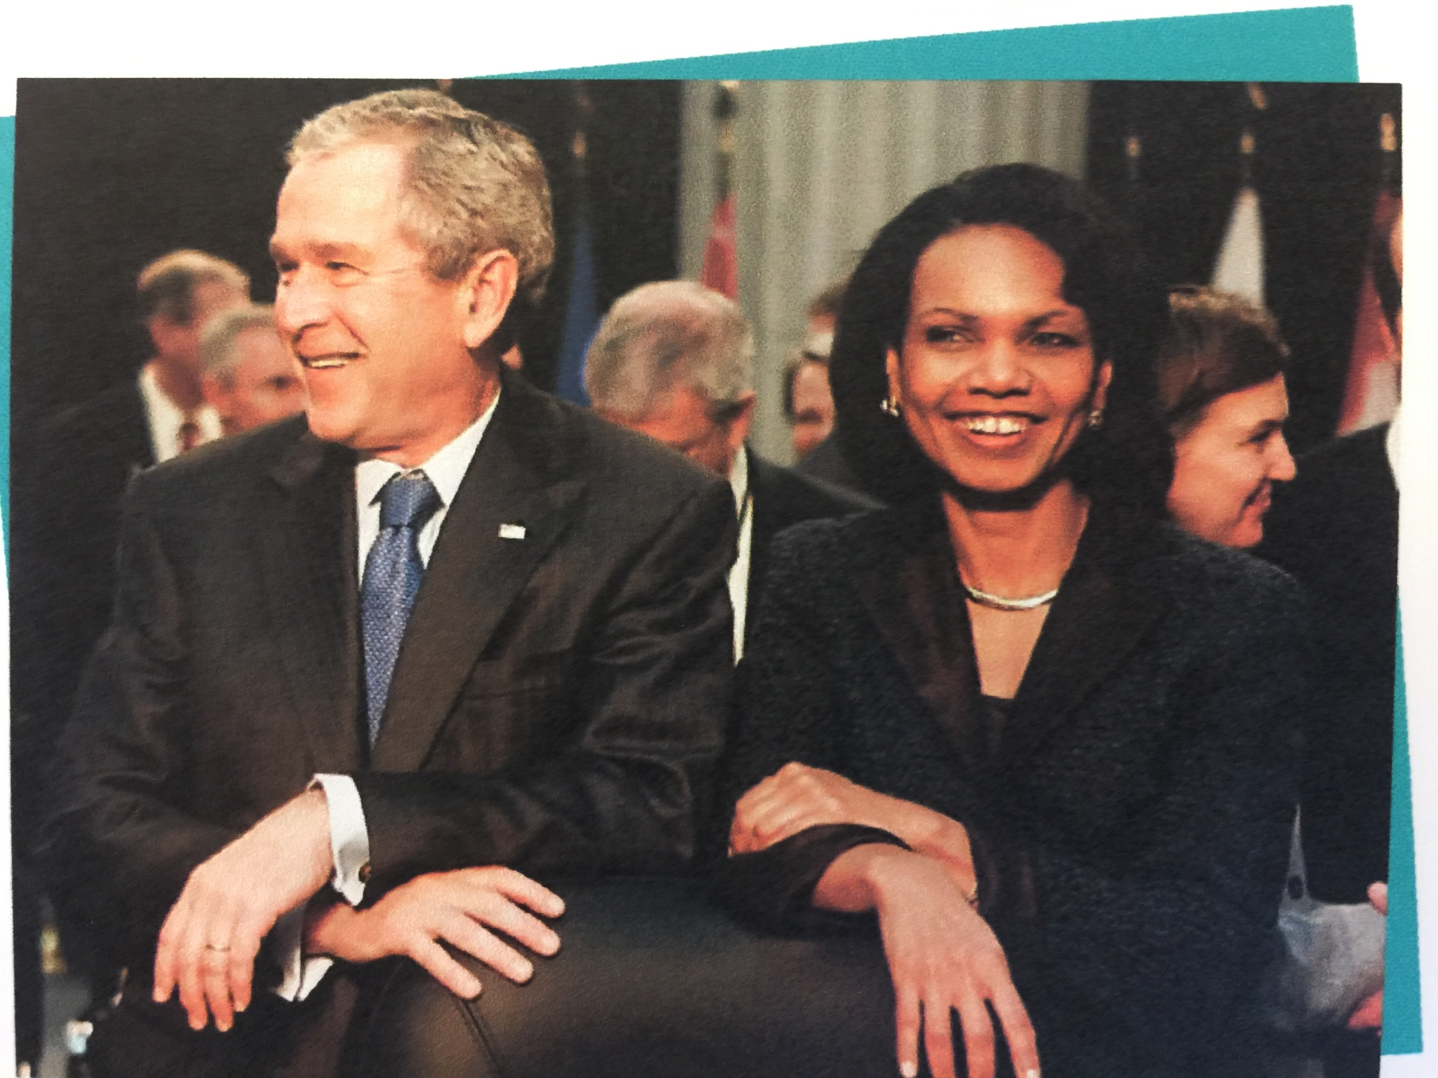

Slide 24
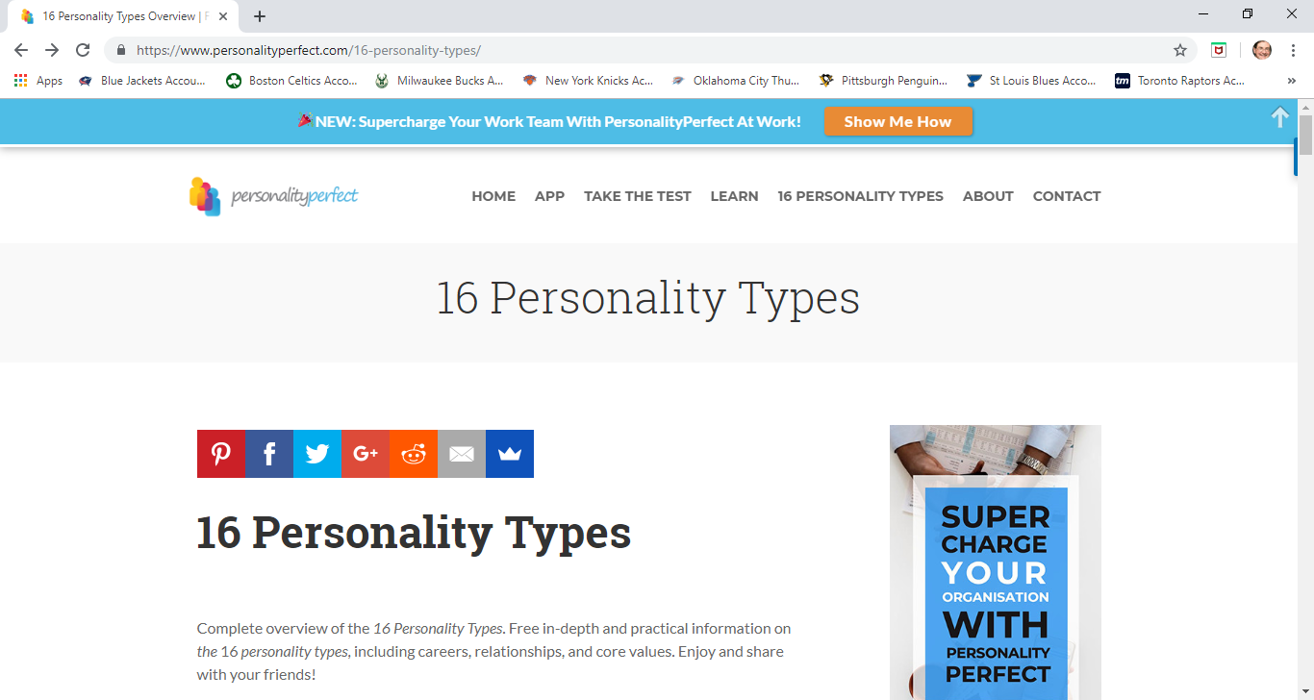
www.personalityperfect.com

Slide 25
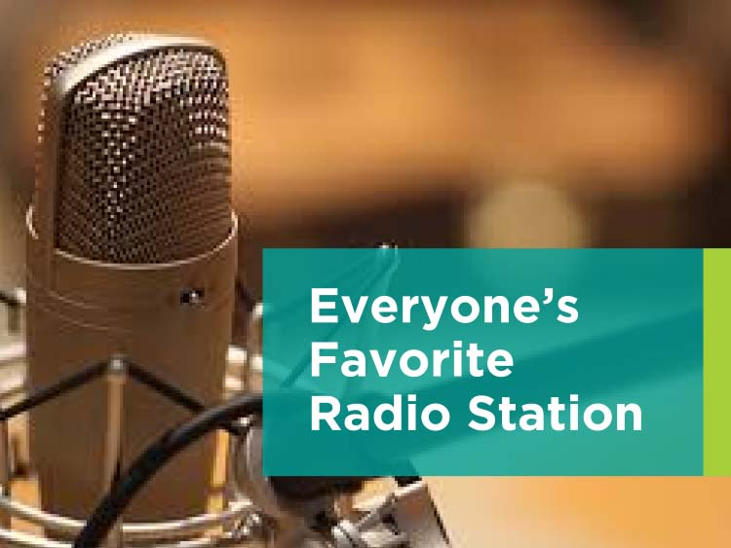

Slide 26
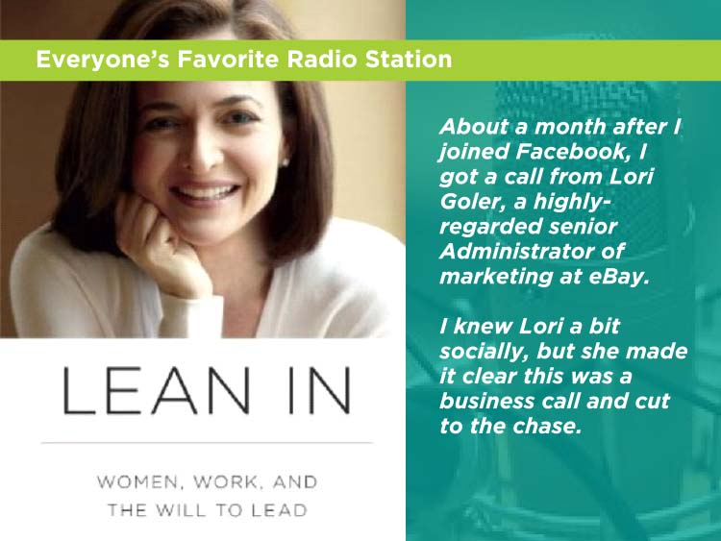

Slide 27
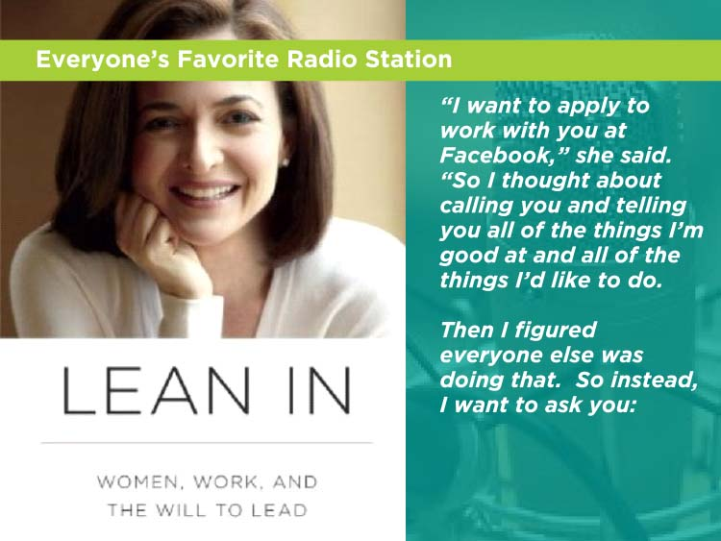

Slide 28
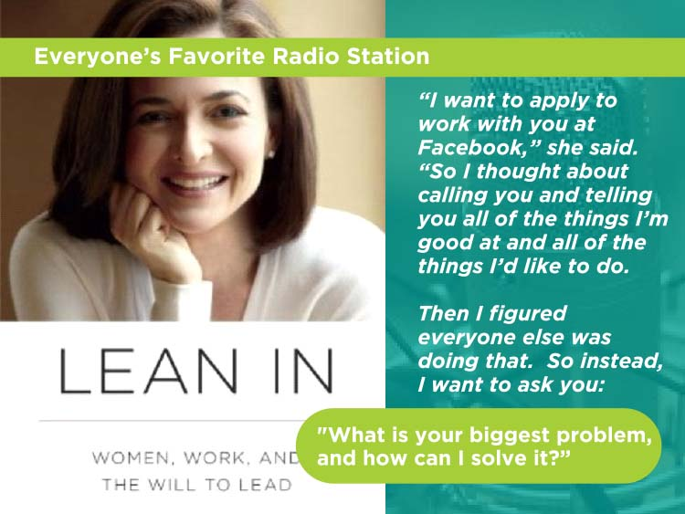

Slide 29
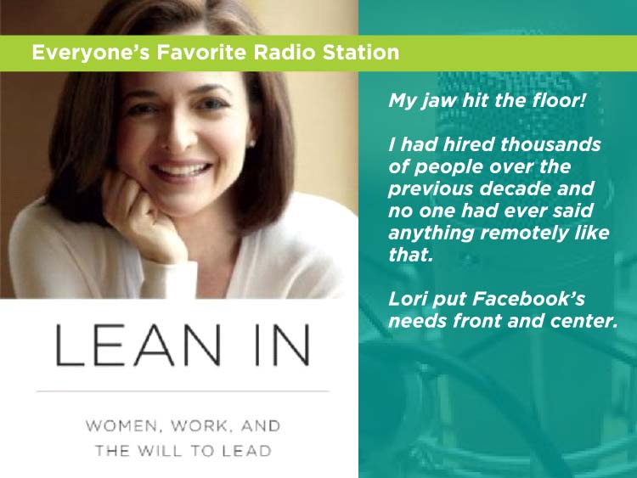

Slide 30
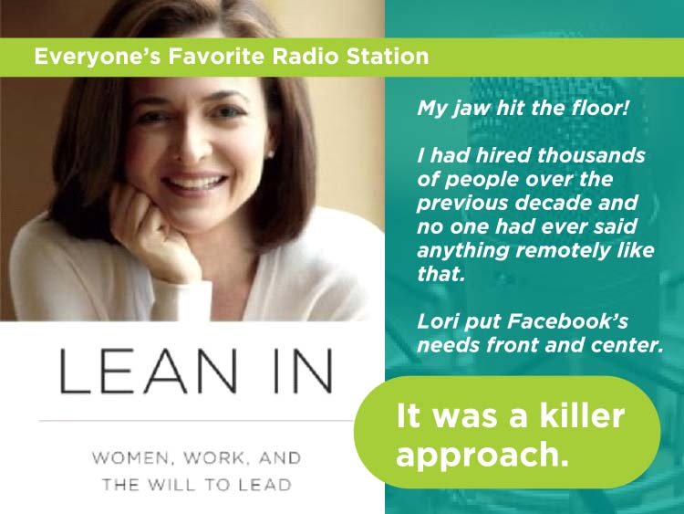

Slide 31
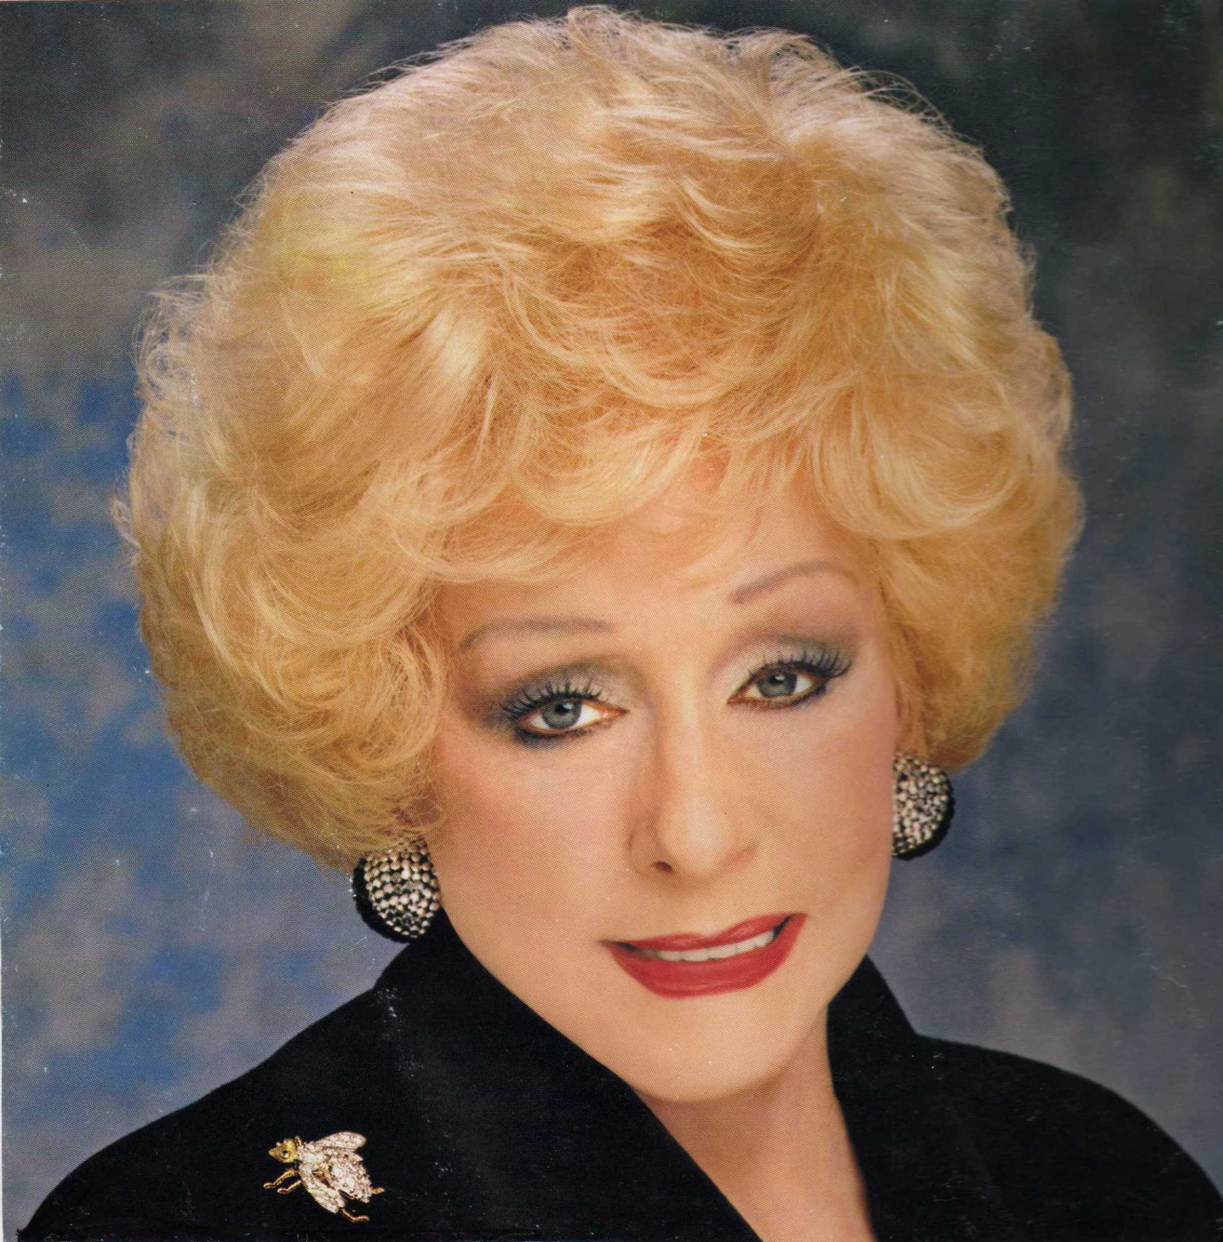

Slide 32
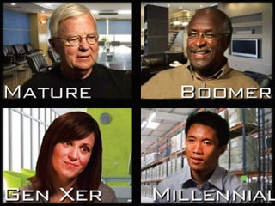
Four Generations of Employees

Slide 33
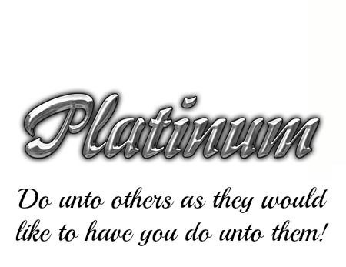
- Dr. Tony Alessandra

Slide 34
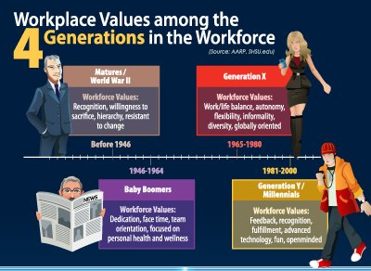

Slide 35

Matures/Silent Generation/Traditionalists
Task orientation
Rules of conduct
Respect for authority
Following directions
Want conformity and rules.

Slide 36

Baby Boomers
Meaningful work
Has a bottom-line impact on the success of the organization
Recognition and appreciation for their extra hours and hard work
Financial rewards.

Slide 37

Generation X
Meaningful work
Healthy work-life balance
Freedom to do their job
A boss who is sensitive to their need for work flexibility and family values
Relaxed dress codes
Flexible leave policies.

Slide 38

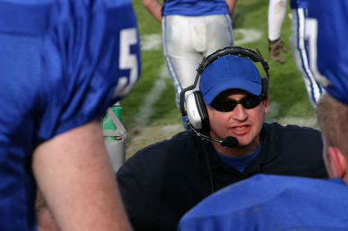
Generation Y
A variety of substantial, important projects
Allow them to learn and use new skills
Work that is personally rewarding (Work to live)
A boss who is like a coach or mentor – dislike bosses who are formal or hierarchical.

Slide 39
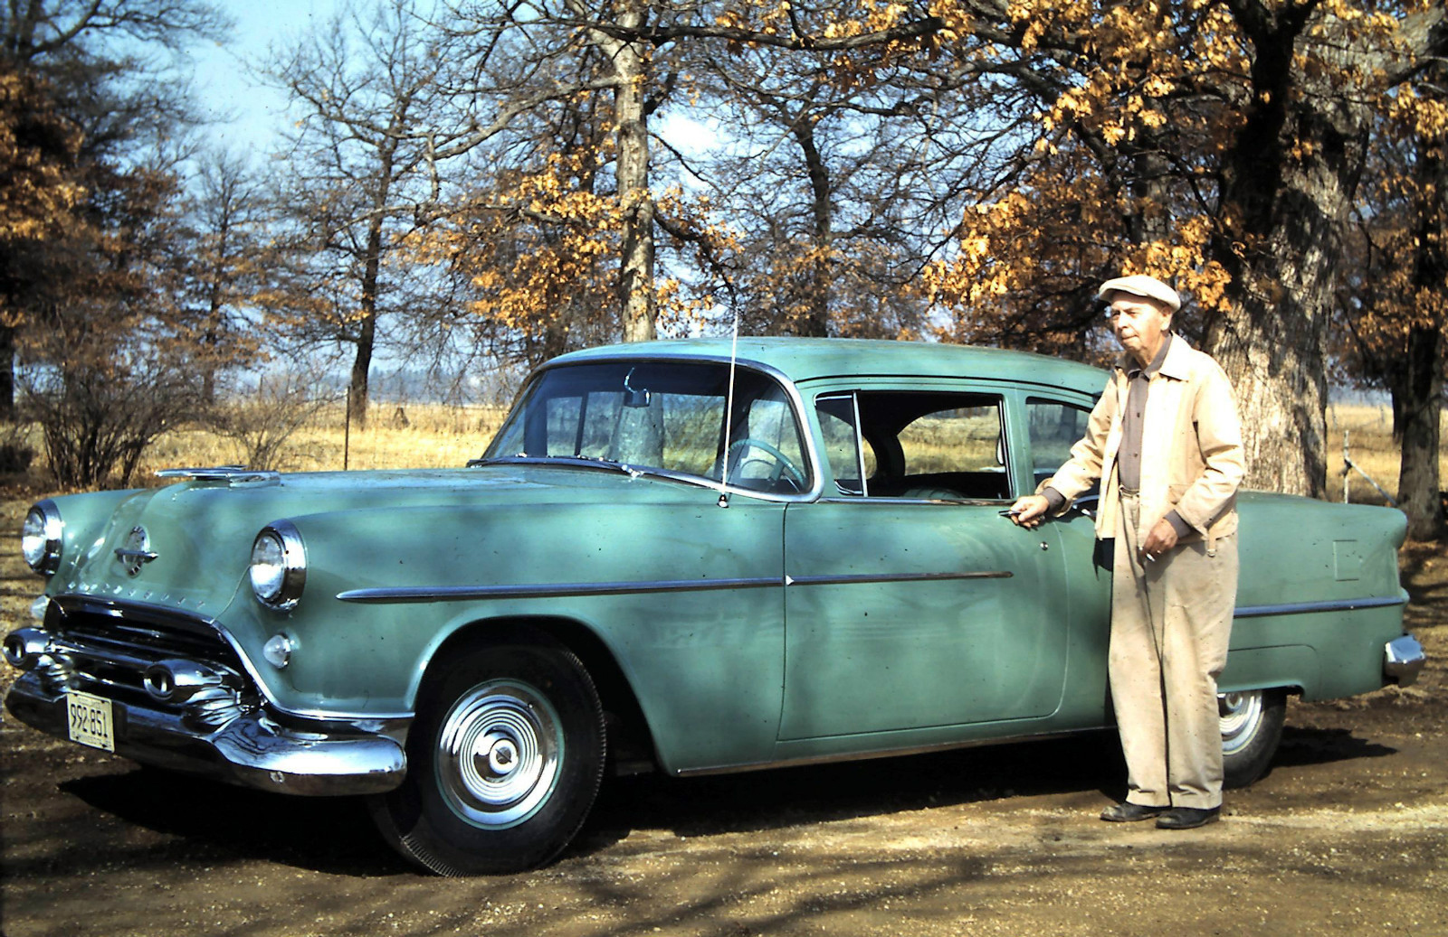
Millennials Don’t Drive Your Father’s Oldsmobile

Slide 40
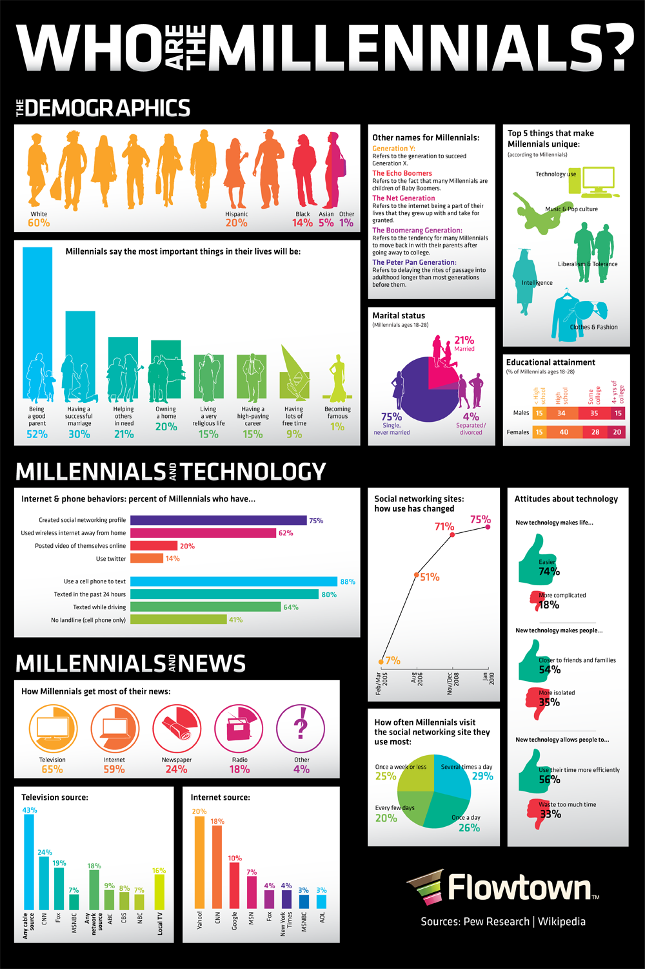

Slide 41
What percent of today’s adults are currently married with children compared to Baby Boomers of the same age?

Slide 42

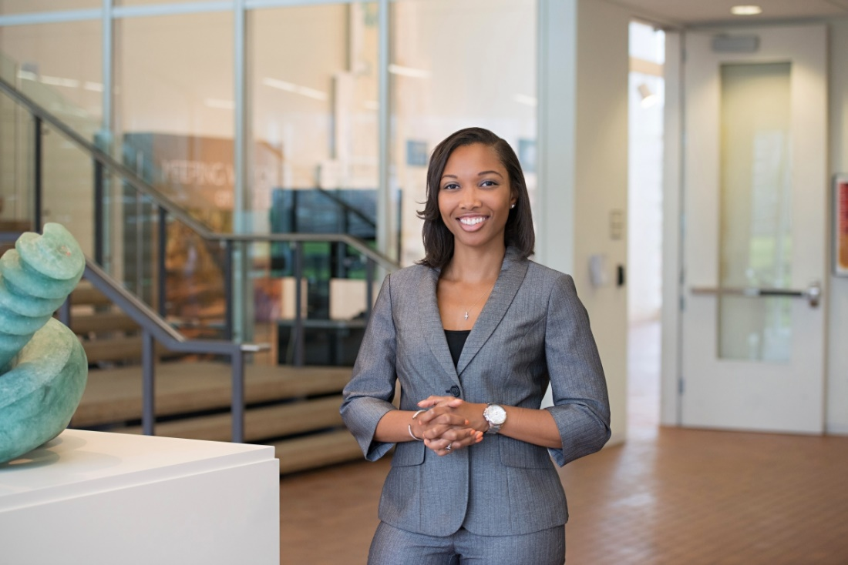
50%
12%

Slide 43
What percent of Millennials expect to stay on the job for less than 3 years?

Slide 44
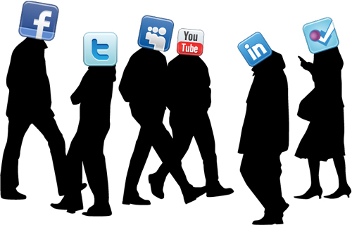
91%
(That would translate to 15-20 jobs over the course of their working lives.)

Slide 45
Where do Millennials want to live?

Slide 46
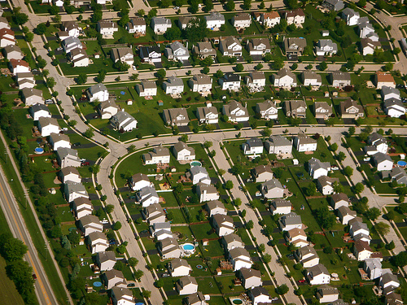


Slide 47
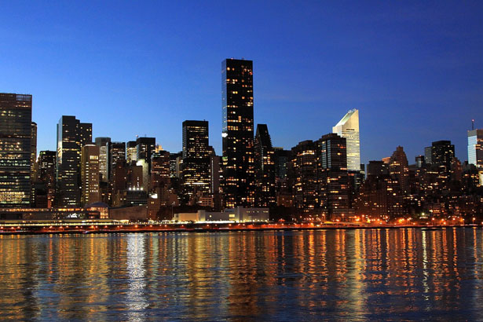
41%

Slide 48
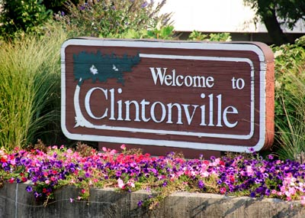


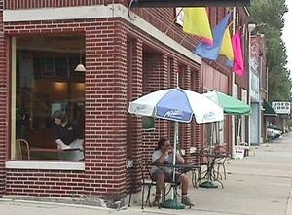

Slide 49

Generation Z
Masters of the Internet
Same company – different jobs
Worry about the world, not their status
Only brand they care about is their own
Cost-conscious
Competitive, not cooperative
Know they will need to work harder.

Slide 51
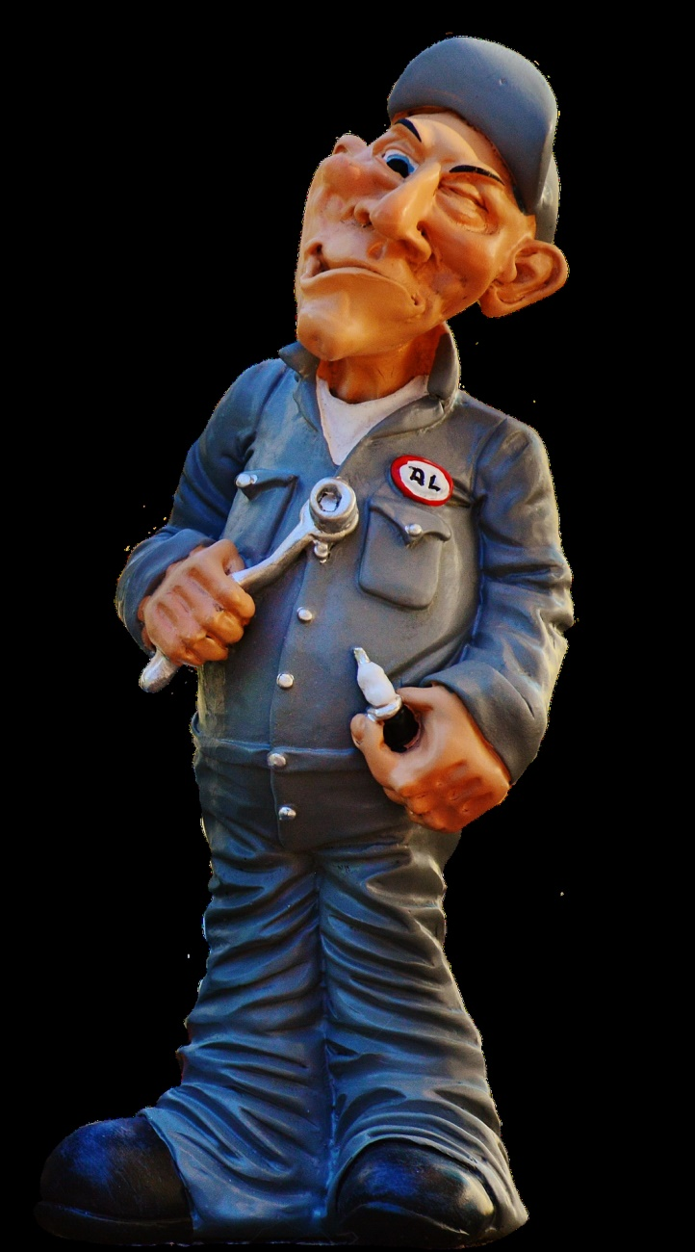
Handling Difficult Situations

Slide 52
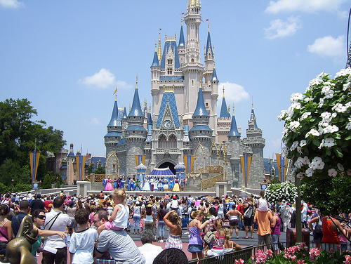

Slide 53
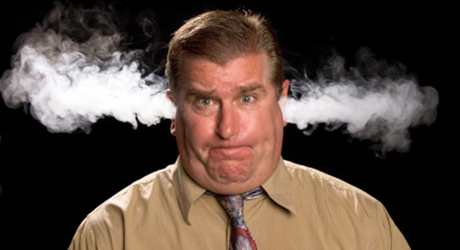

Slide 54
OUTSTANDING CUSTOMER SERVICE
THE DISNEY WAY
L
E
A
D

Slide 55
OUTSTANDING CUSTOMER SERVICE
THE DISNEY WAY
L - Listen
E
A
D

Slide 56
OUTSTANDING CUSTOMER SERVICE
THE DISNEY WAY
L - Listen
E - Empathize
A
D

Slide 57
OUTSTANDING CUSTOMER SERVICE
THE DISNEY WAY
L - Listen
E - Empathize
A - Apologize
D

Slide 58
OUTSTANDING CUSTOMER SERVICE
THE DISNEY WAY
L - Listen
E - Empathize
A - Apologize
D - Do Something

Slide 61
QUESTIONS?

